Slide 1
Society of Thoracic Surgeons Intermacs & Pedimacs Monthly Webinar
September 25, 2024

Slide 2
The Intermacs Data Warehouse Team
Ryan Cantor, PhD, Chief Scientific Officer, Intermacs Data Warehouse
Brandon Singletary, PhD, Statistician III, Epidemiologist, Intermacs Data Warehouse
Rama Rudraraju, PhD, Director of Programming, Intermacs Data Warehouse
Maceo Cleggett , Clinical Data Analyst , Intermacs Data Warehouse
John Pennington, MSHI, Director of Data Management, Intermacs Data Warehouse
Notes:
All things work because of us all working together

Slide 3
Intermacs Database Webinar
Welcome and Introductions
STS Updates
Form Edits

Slide 4
Data Manager Collaboration Program Adie Dolan STS National Database Coordinator

Slide 5
Data Manager Collaborative (DMC)
Formerly the Data Manager Mentorship Program
Benefits of participation
How do I sign up?
https://www.sts.org/form/sts-nd-data-manager-collaborativ

Slide 6
What’s New?
AQO was fantastic!
Upcoming Form Edits
Q2 Reports distributed September 30th
Data Entry Deadline for Q3 October 31st

Slide 7
AQO 2024
Thank you to all our amazing speakers and attendees!
The AQO Virtual Meeting Platform is open
If you wish to view any presentation slides, handouts or case scenarios, visit the platform.
On-demand sessions are available now, and recordings of the live sessions will be available in early October-mid December.
Don't forget to evaluate sessions and claim your continuing education credits. You must watch all on-demand and live content and evaluate all presentations. The deadline for claiming credit is Friday, December 13, 2024.
AQO Hot Topics Webinar is Tuesday, October 29th.

Slide 8
AQO 2025
Next year’s AQO will be both virtual and in-person
Location is between Chicago and New Orleans

Slide 9
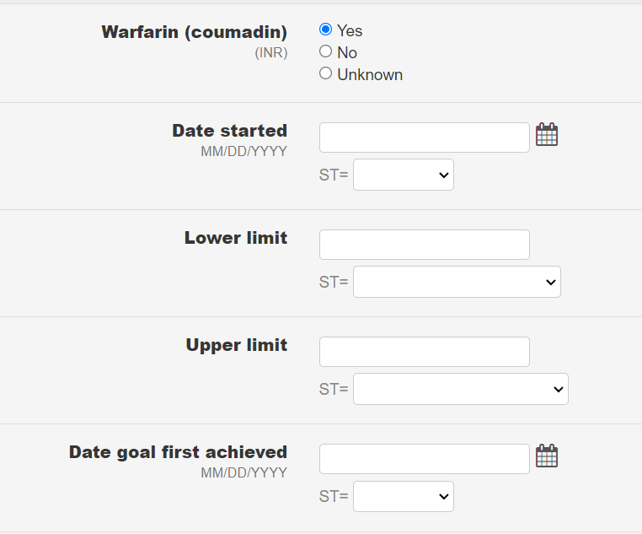
PreImplant & Follow-Up
Adding Coumadin Targets

Slide 10
PreImplant & Follow-Up
Stroke Timing
On the Comorbidities Form we are adding the following helper text:
Recent (within 30 days of visit)
Remote (greater than 30 days of visit)

Slide 11
Implant Form
Child question for Thoratec Centrimag and TandemHeart

Slide 12
Explant Form
RVAD/ECMO Helper Text
On the Explant form under the device explanted question we’re adding helper text that reads “Do not explant RVAD due to addition of an oxygenator, ProtekDuo, Spectrum Dual Lumen, etc. cannulas”.

Slide 13
Resources
https://intermacs.kirso.net/intermacs-documents/ (All Things Intermacs and Pedimacs, Database User Guides, Data Collection Forms, QoL Surveys, FAQs, V6.0 Training Video)
intermacs@kirso-admin.net (Password and Login)
reports@kirso-admin.net (Reporting Questions)

Slide 14
Contact Information
Nancy Honeycutt, BSN, RN STS National Database Manager, Intermacs and Pedimacs
nhoneycutt@sts.org
Patricia Potter, BSN, RN, Intermacs Data warehouse Manager of Clinical Affairs
patricia.potter@kirso.net
This Photo by Unknown author is licensed under CC BY-SA.

Slide 15
Important Dates
30 Sep.
Q2 Reports Distributed
29 Oct.
AQO Hot Topics Webinar
30 Oct.
Monthly Webinar
31 Oct.
Q3 Data Entry Deadline

Slide 16
Open Discussion
Please use the Q&A Function.
We will answer as many questions as possible.
We encourage your feedback and want to hear from you!

Slide 17
THANK YOU FOR JOINING!

